Slide 1
AIRWAY MANAGEMENT
R1 เกียรติศักดิ์ / อ.ศิริลักษณ์

Slide 2
Outline
Airway anatomy and function
Evaluation of airway
Clinical management of the airway
Difficult airway management
Take home massage

Slide 3
Airway anatomy
Upper airway
Lower airway
Nasal
Oral cavities
Pharynx
Larynx
Trachea
Tracheobronchial tree

Slide 4
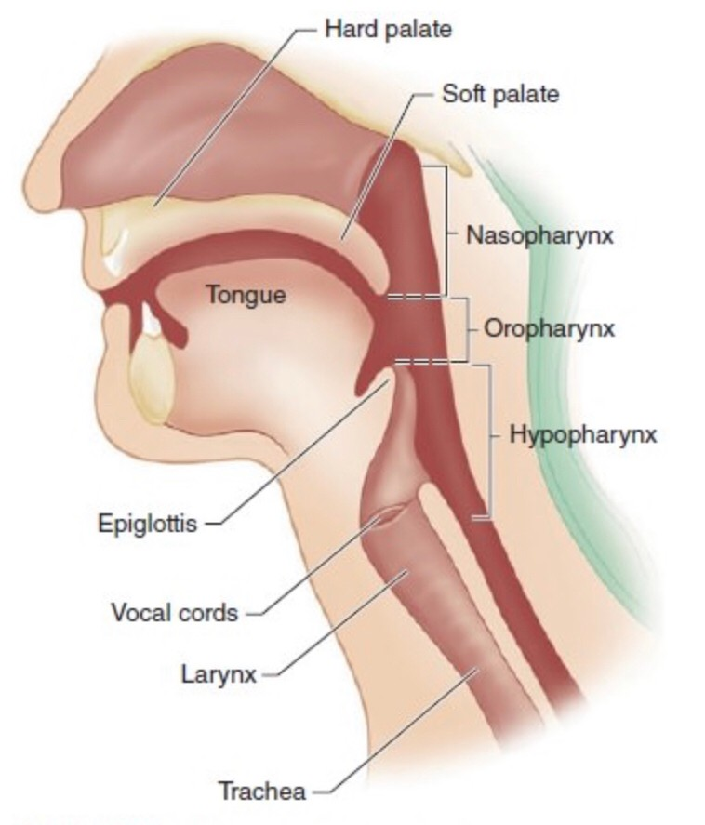

Slide 5
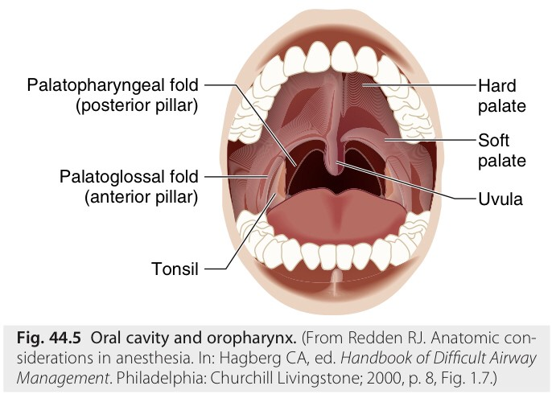
Oral cavity
Miller’s Anesthesia 9th Edition

Slide 6
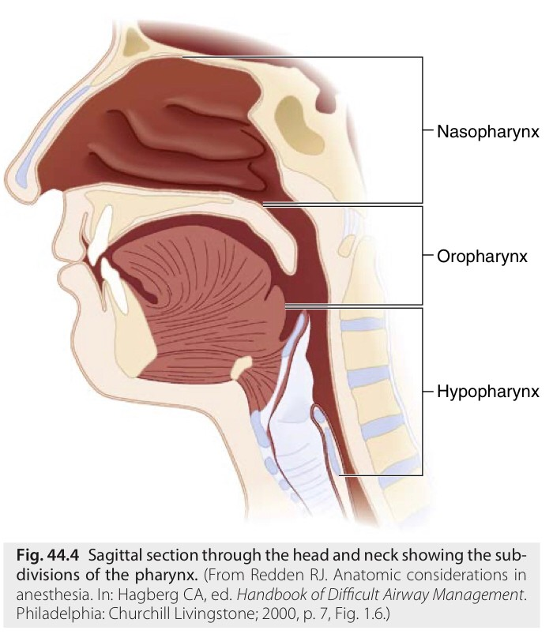
Pharynx
Miller’s Anesthesia 9th Edition

Slide 7
Larynx
Protective mechanism
Phonation
Location : C3-C6 vertebrae in adult
C2-C3 vertebrae in infant
Narrowest portion : Vocal cord in adult
Cricoid cartilage in children
Cricoid cartilage complete ring : > 8 years

Slide 8
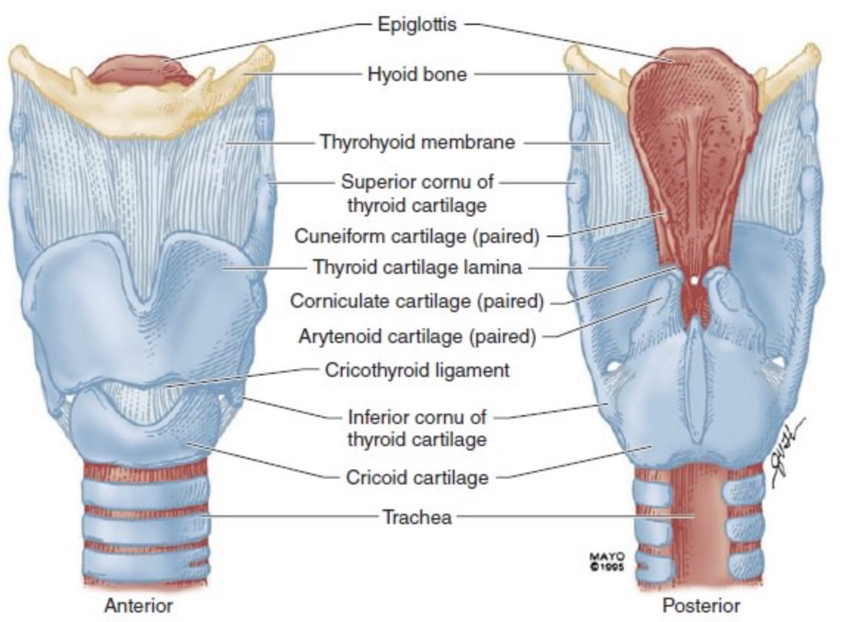
Larynx

Slide 9
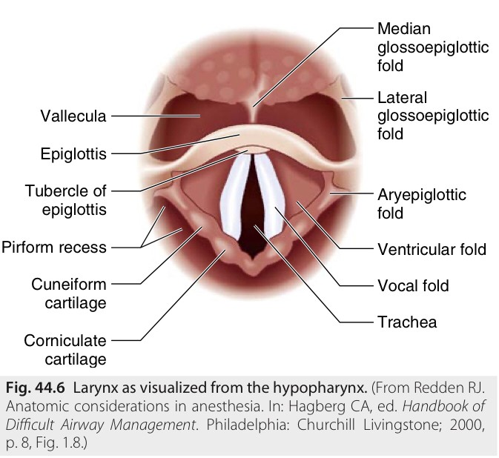
Larynx
Miller’s Anesthesia 9th Edition

Slide 10
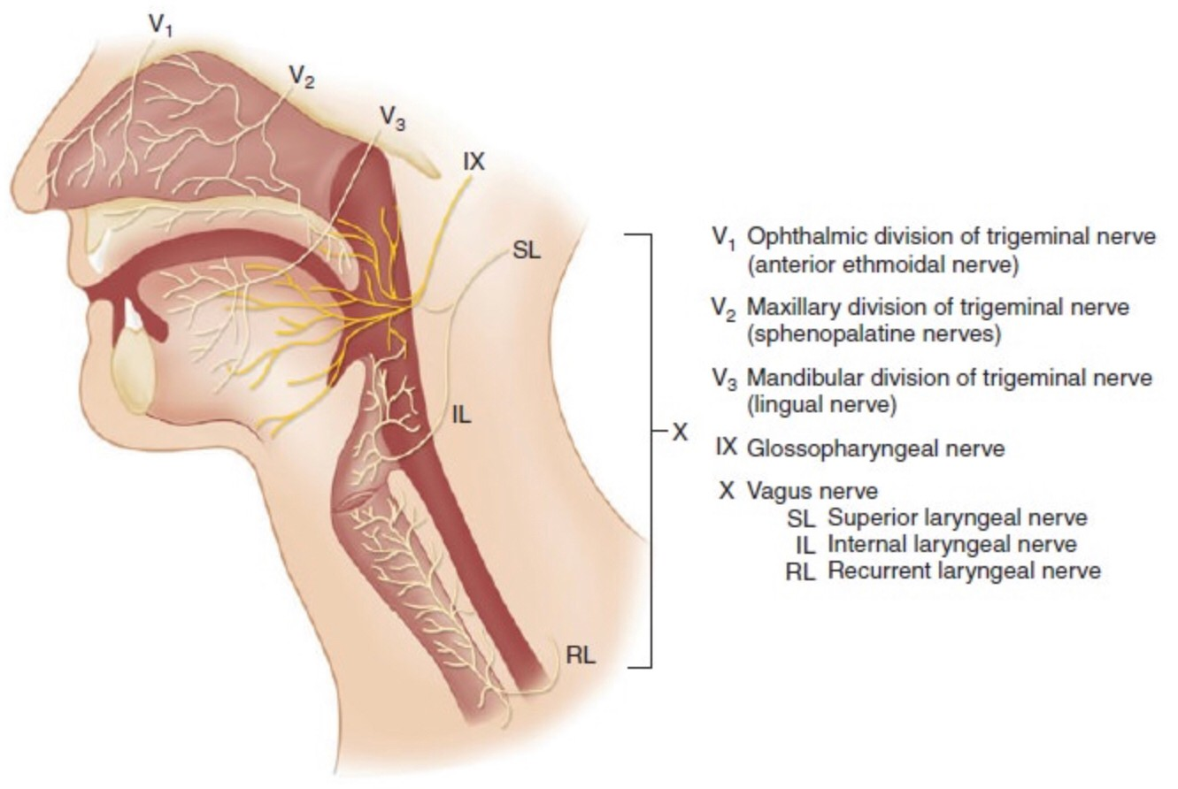
Nerve supply

Slide 11
Innervation
Superior Laryngeal Nerve
Recurrent Laryngeal Nerve
Internal branch : sensory from tongue to vocal cord
External branch : Motor cricothyroid muscle
Sensory below vocal cord
Intrinsic muscle except cricothyroid muscle

Slide 12
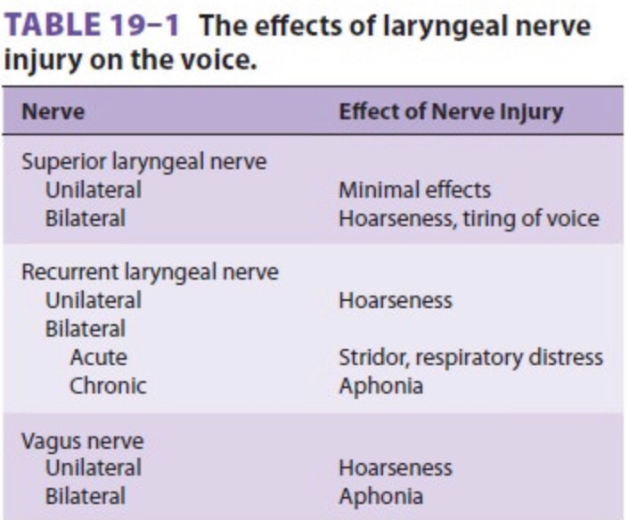

Slide 13
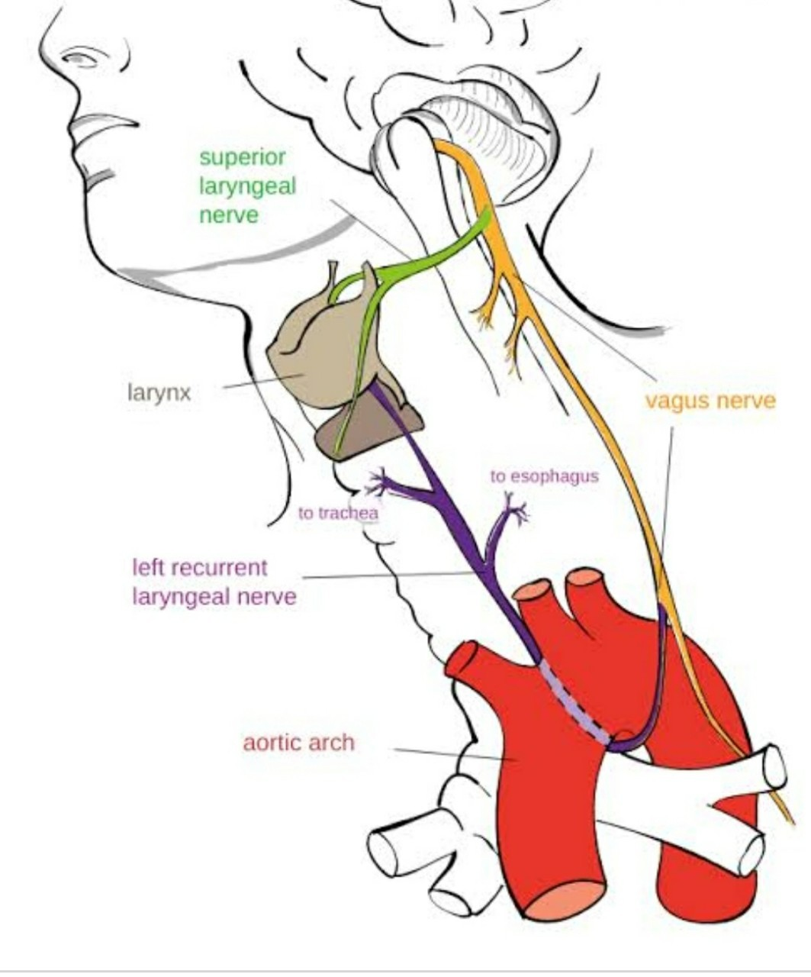

Slide 14
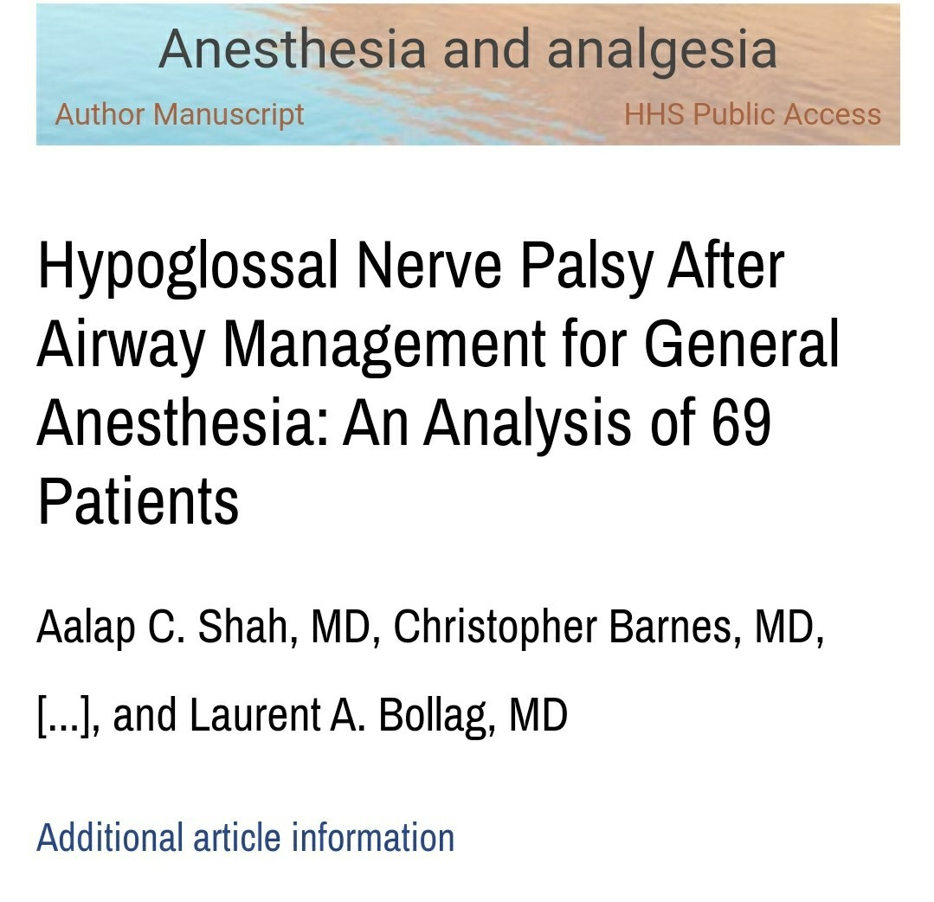

Slide 15
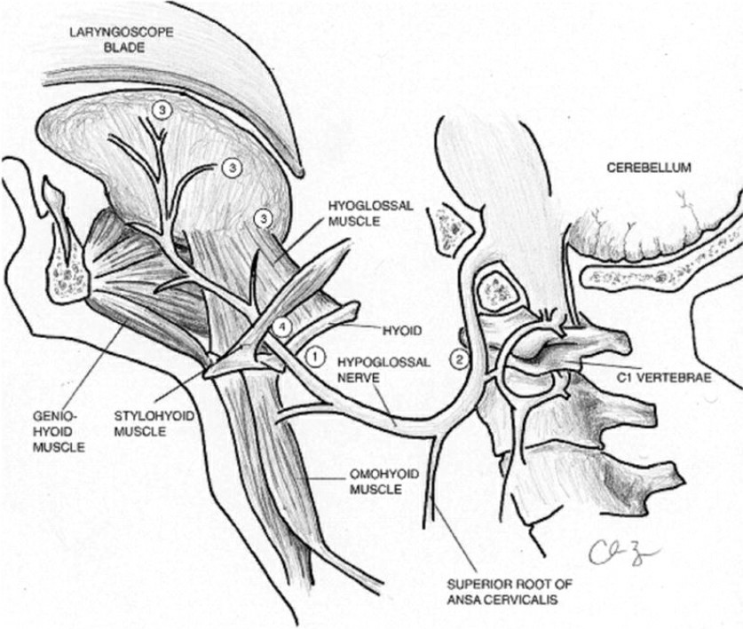

Slide 16
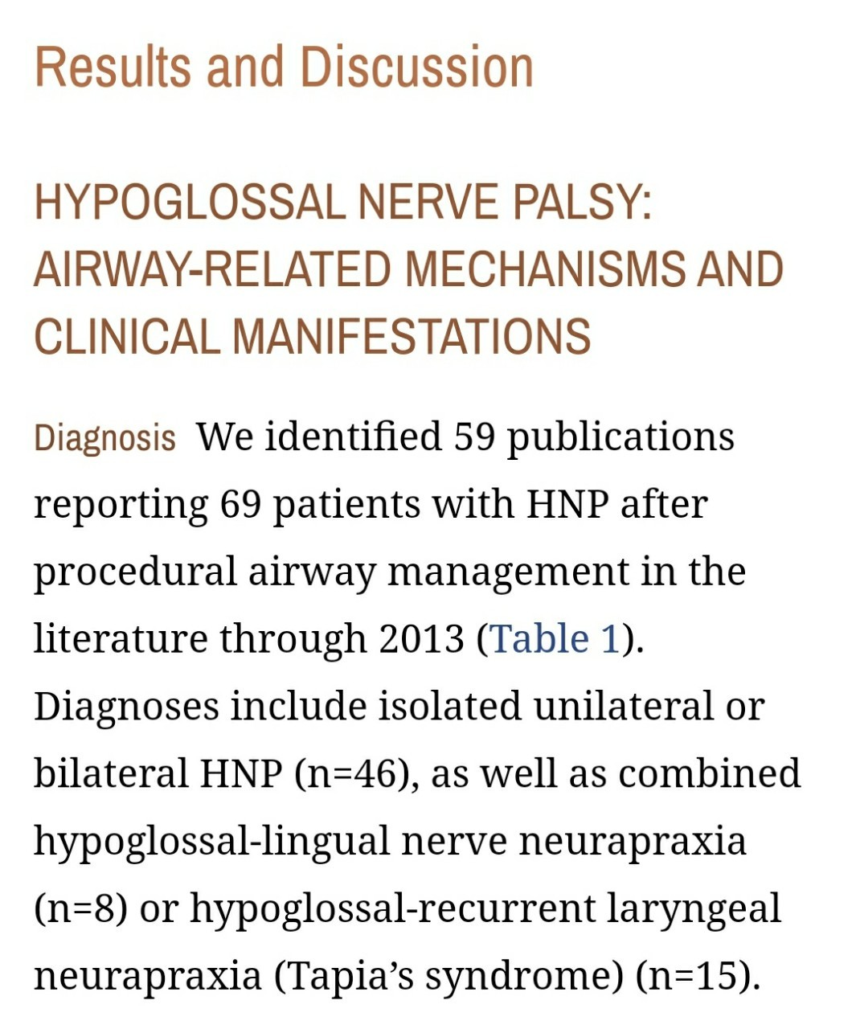

Slide 17
Evaluation of airway
History
Physical examination
Screening test

Slide 18
History
History of the patient’s airway experience
Review of previous anesthetic

Slide 19
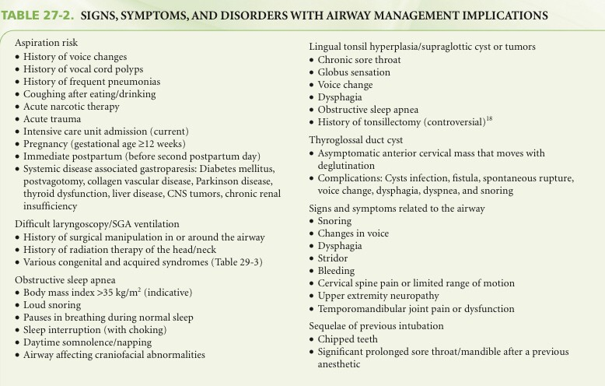
Clinical anesthesia/edited by Paul G. Barash 7th ed.

Slide 20
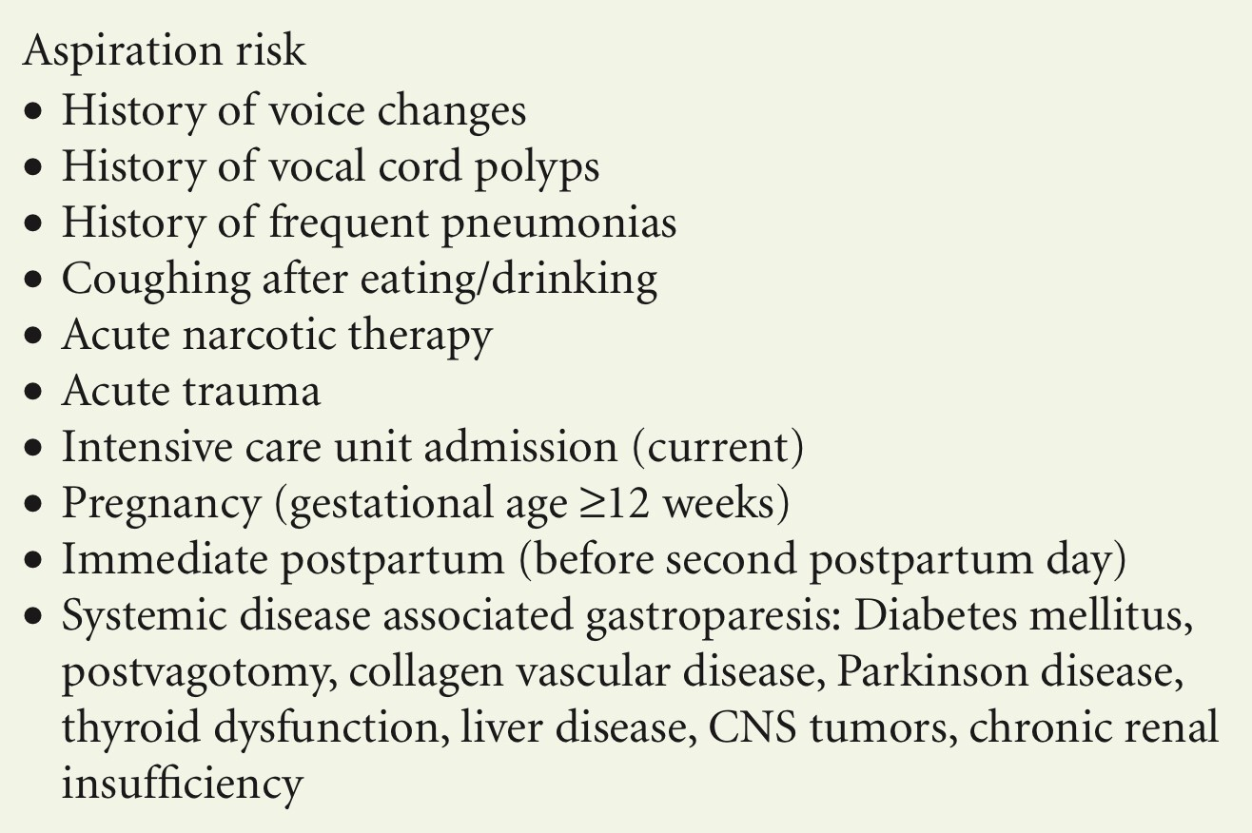
Clinical anesthesia/edited by Paul G. Barash 7th ed.

Slide 21
Clinical anesthesia/edited by Paul G. Barash 7th ed.

Slide 22
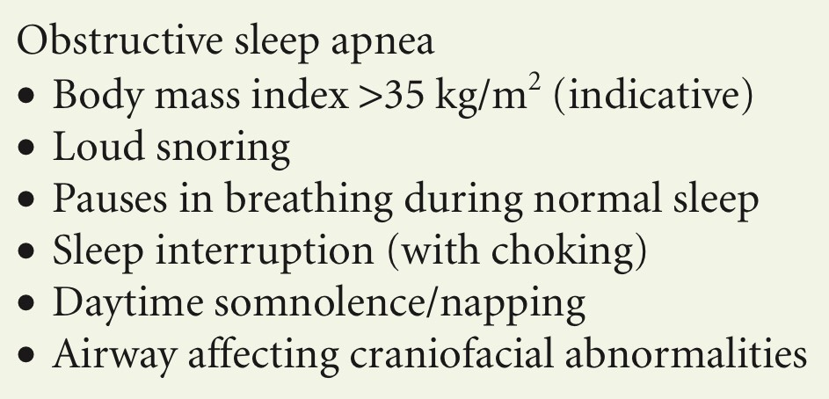
Clinical anesthesia/edited by Paul G. Barash 7th ed.

Slide 23
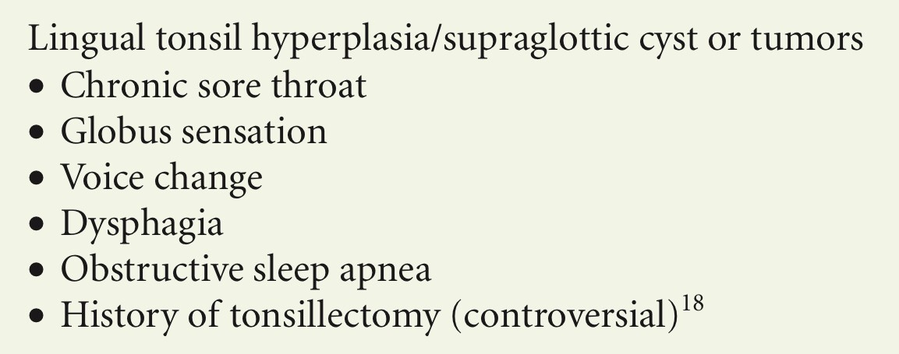
Clinical anesthesia/edited by Paul G. Barash 7th ed.

Slide 24
Clinical anesthesia/edited by Paul G. Barash 7th ed.

Slide 25
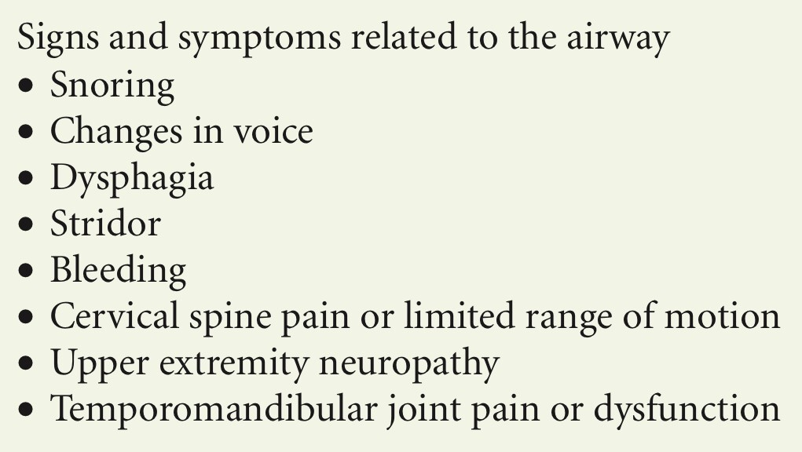
Clinical anesthesia/edited by Paul G. Barash 7th ed.

Slide 26
Clinical anesthesia/edited by Paul G. Barash 7th ed.

Slide 27
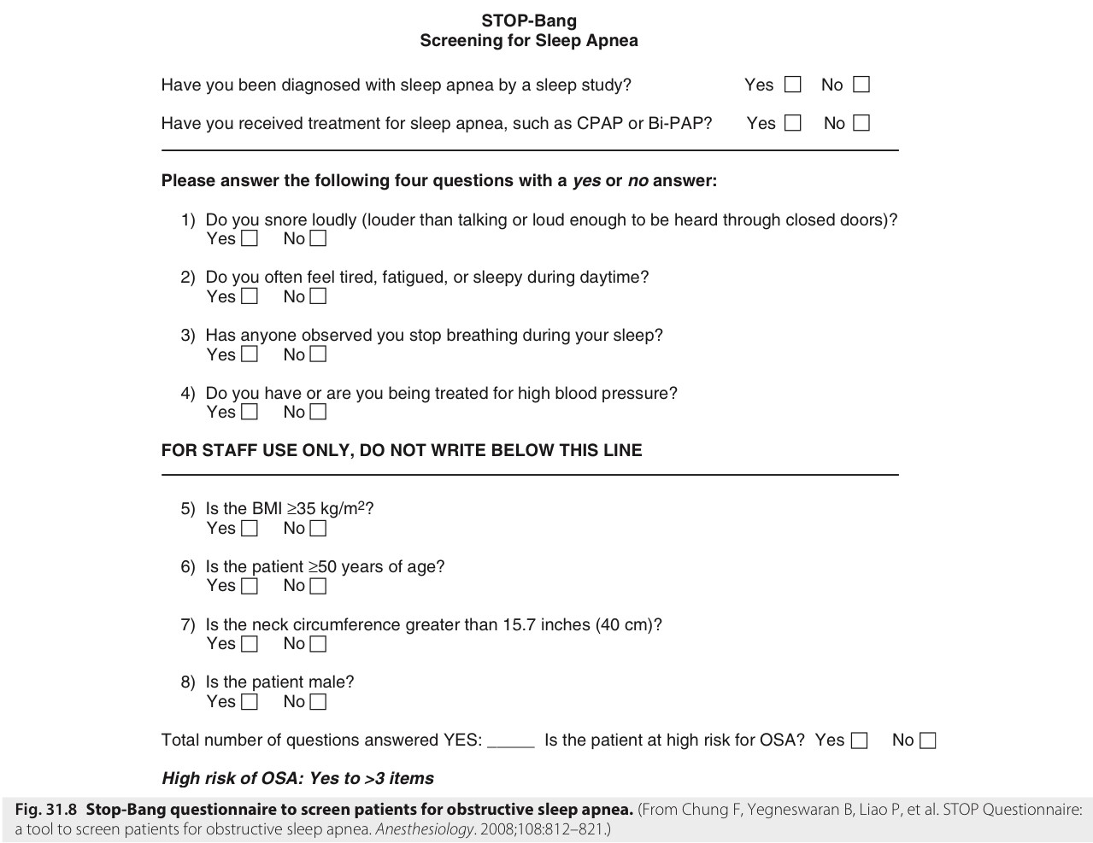
Miller’s Anesthesia 9th Edition

Slide 28
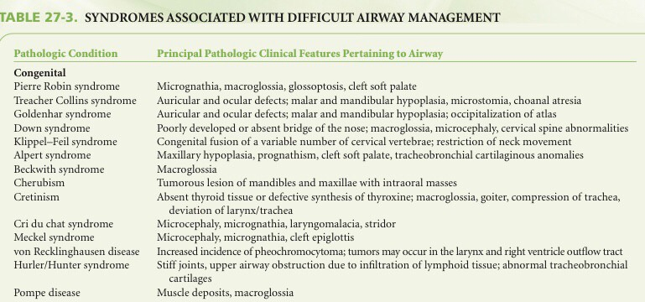
Clinical anesthesia/edited by Paul G. Barash 7th ed.

Slide 30
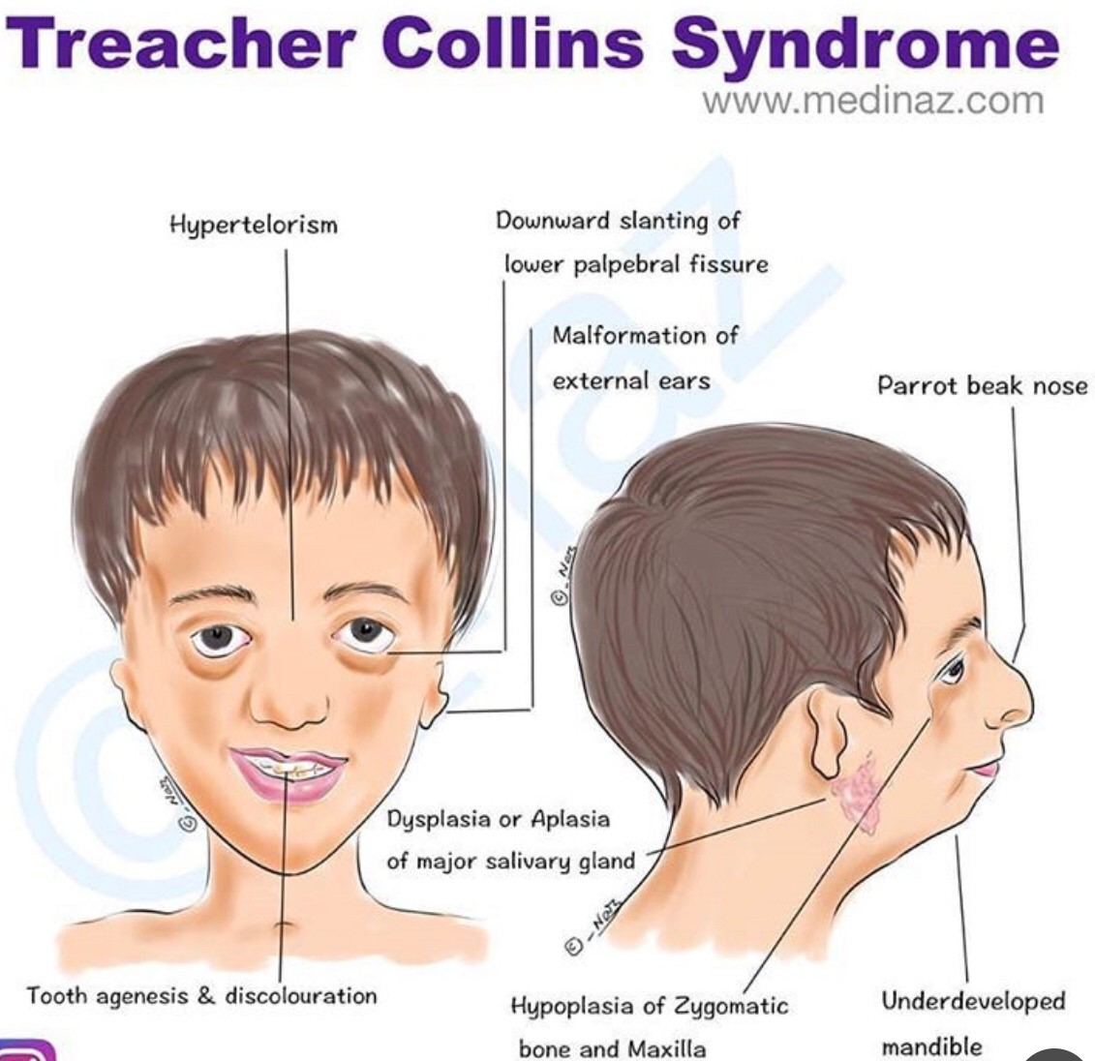

Slide 31
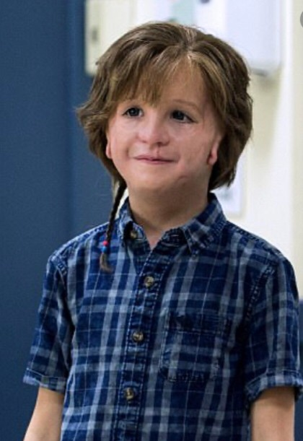

Slide 32
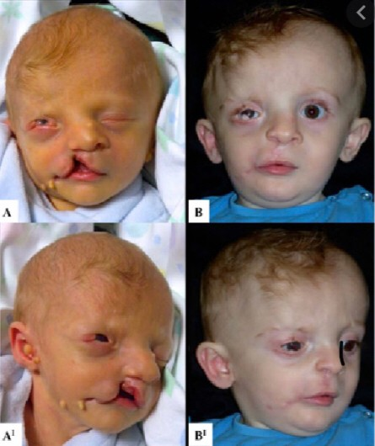
Goldenhar syndrome

Slide 33
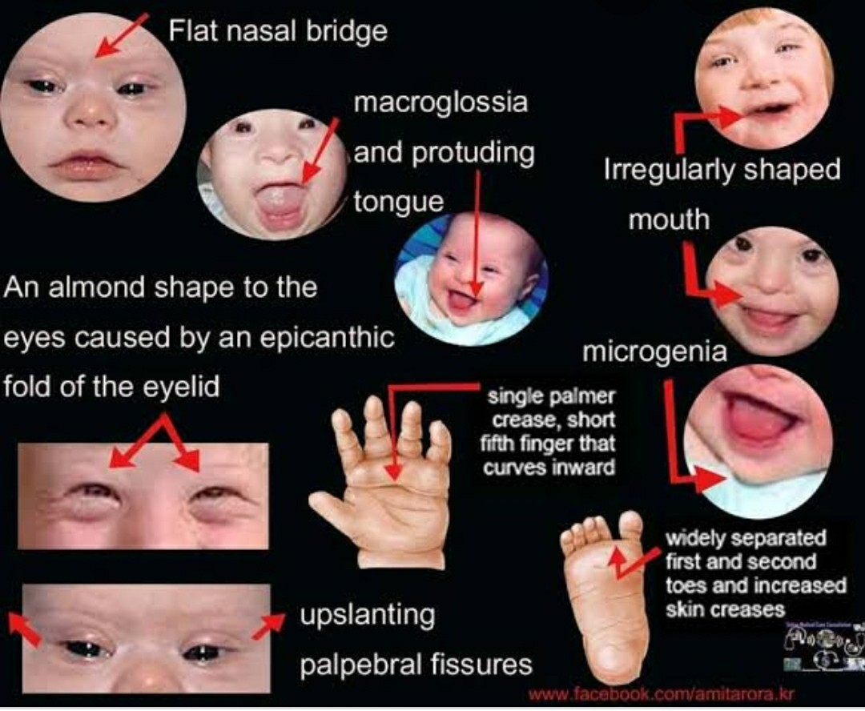

Slide 34
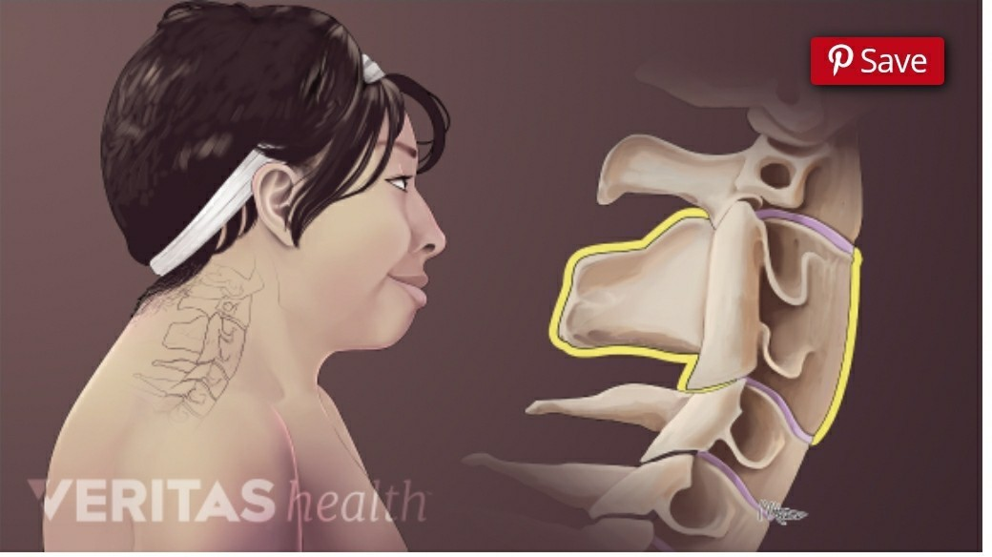
Klippel-Feil syndrome

Slide 35
Physical examination
Evaluation
Difficult Ventilation
Difficult Intubation

Slide 36
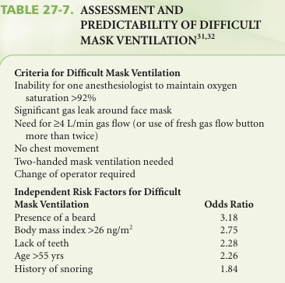
Mask ventilation
M : Mask seal
O : Obesity
A : Age
N : No teeth
S : Snore or Stiff
Clinical anesthesia/edited by Paul G. Barash 7th ed.

Slide 37
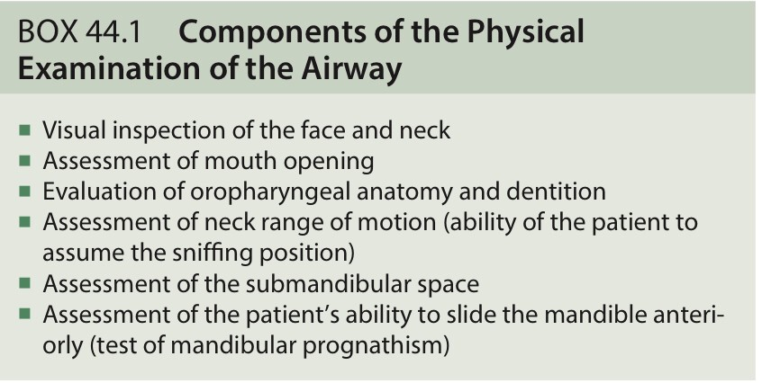
Intubation
Miller’s Anesthesia 9th Edition

Slide 38
Intubation
L : Look external
E : Evaluate 3-3-2
3: Inter-incisor distance
3: Hyoid mental distance
2: Thyroid to floor of mouth
M : Mallampati score
O : Obstruction
N : Neck mobility

Slide 40
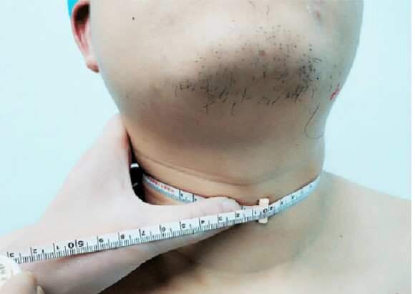
Neck circumference
Adam’s apple
Male > 17 inches
Female > 16 inches

Slide 41
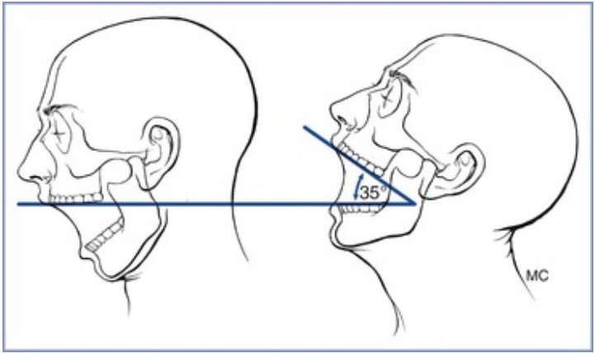
Atlanto occipital joint extension

Slide 42
Screening test
Mallampati test
Thyromental distance
Sternomental distance
Mouth opening test
Upper lip bite test

Slide 43
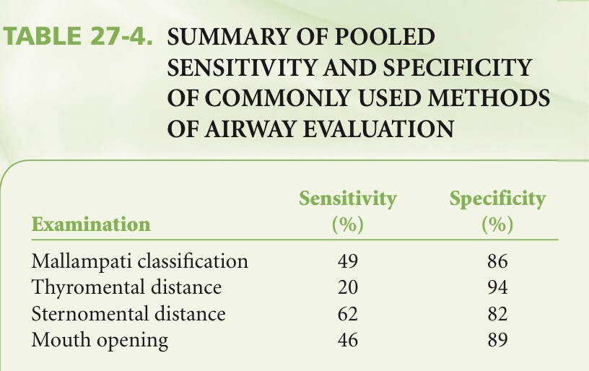
Clinical anesthesia/edited by Paul G. Barash 7th ed.

Slide 44
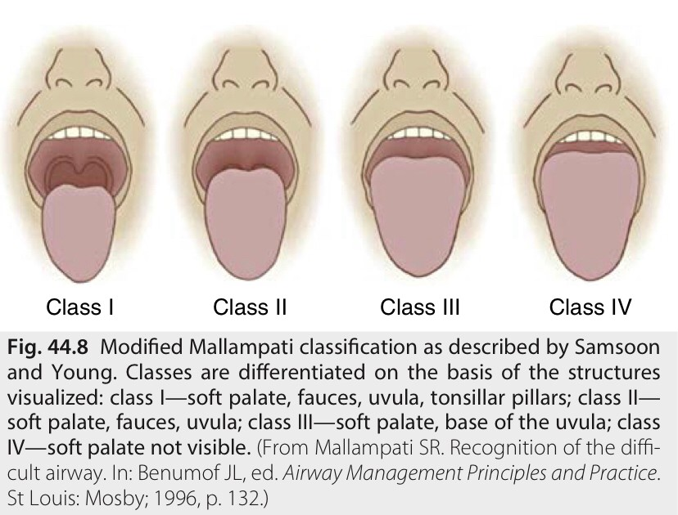
Mallampati test
Miller’s Anesthesia 9th Edition

Slide 45
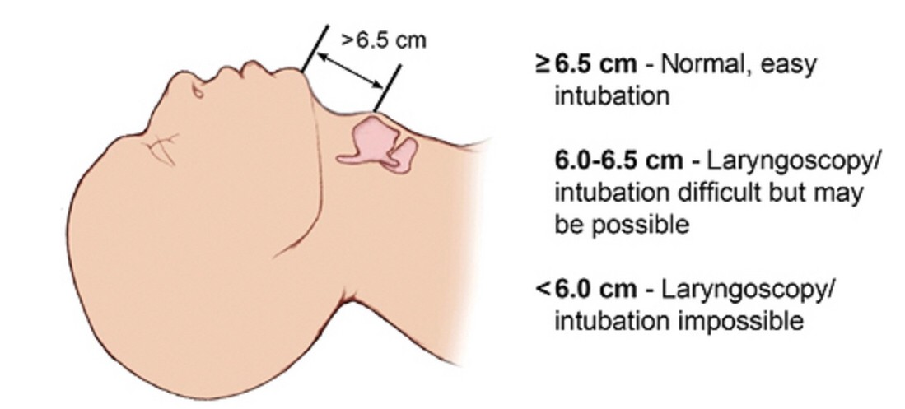
Thyromental distance

Slide 46
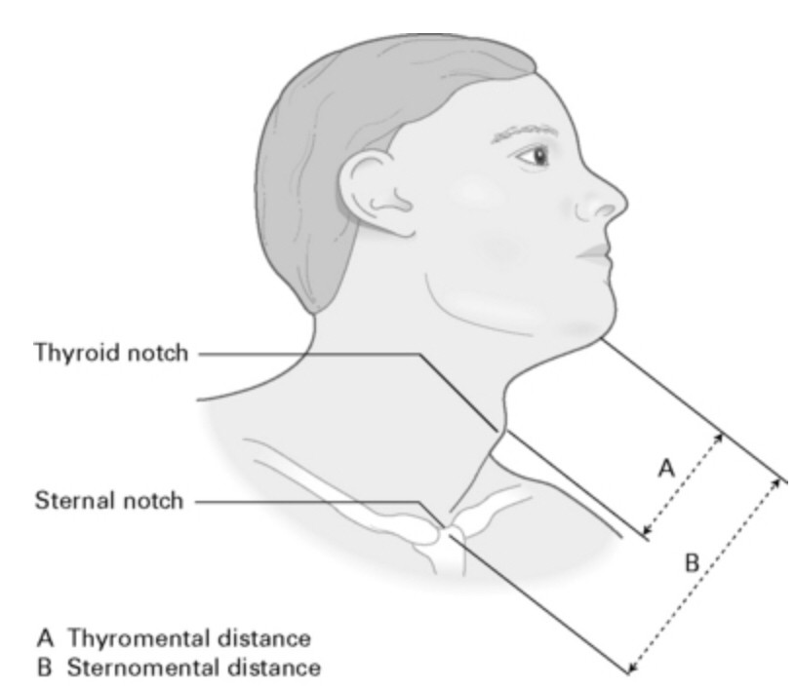
Sternomental distance

Slide 47
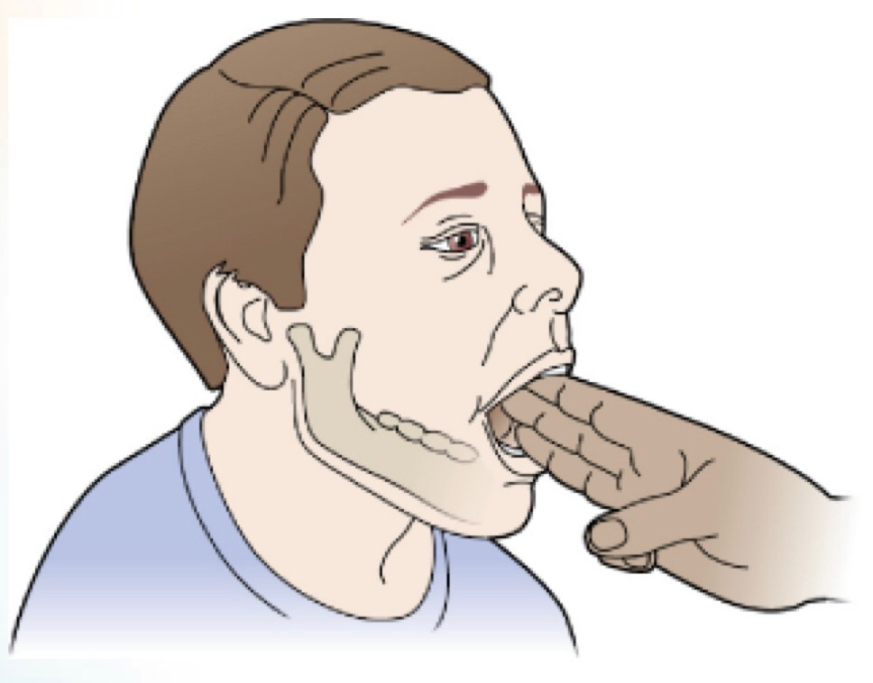
Mouth opening test

Slide 48
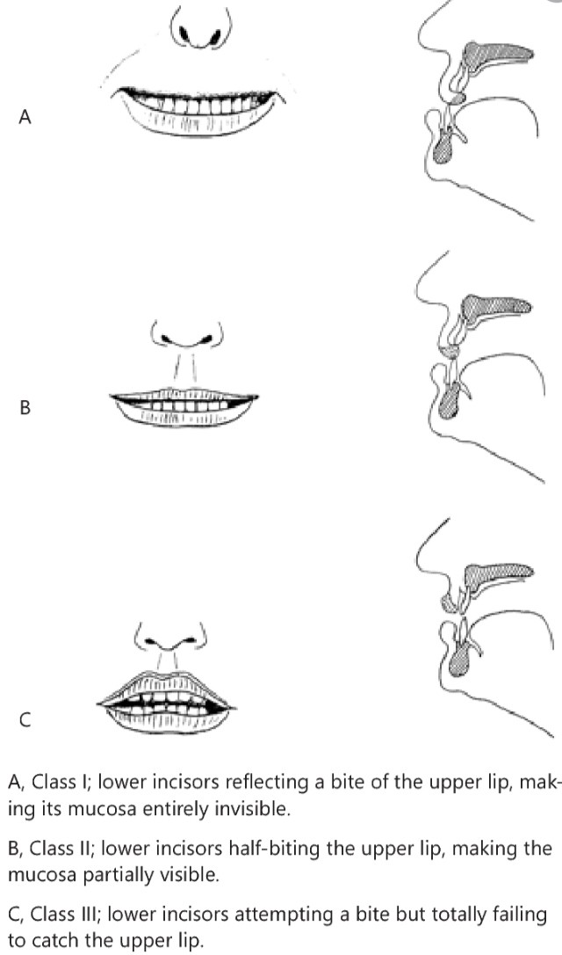
Upper lip bite test

Slide 49
Airway associated with difficult airway
Miller’s Anesthesia 9th Edition

Slide 50
Open airway
Position
Device
Head tilt – chin lift
Jaw thrust
Tripple airway maneuver
Oral airway
Nasal airway

Slide 51
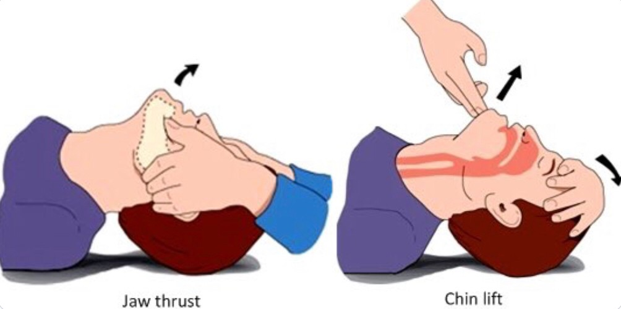
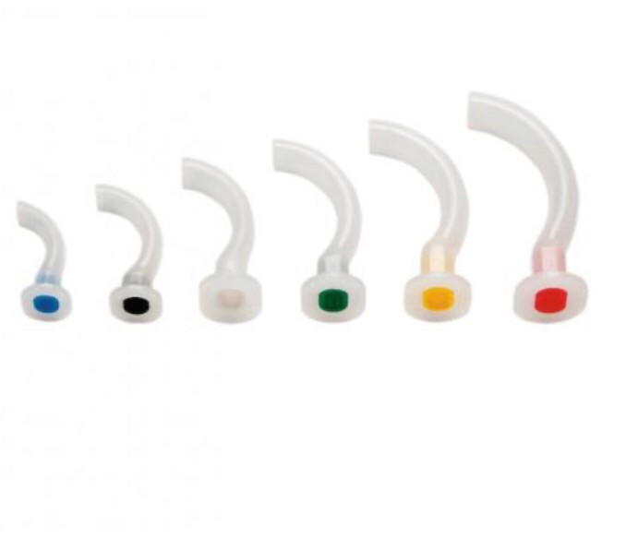
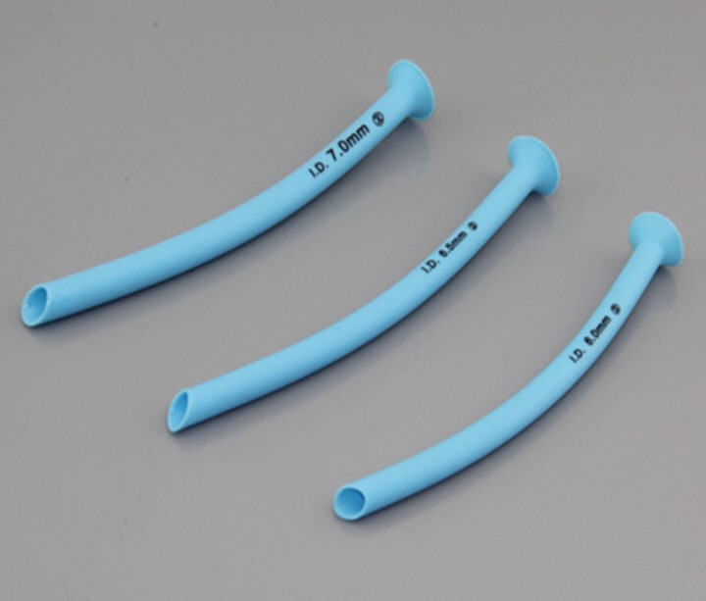

Slide 52
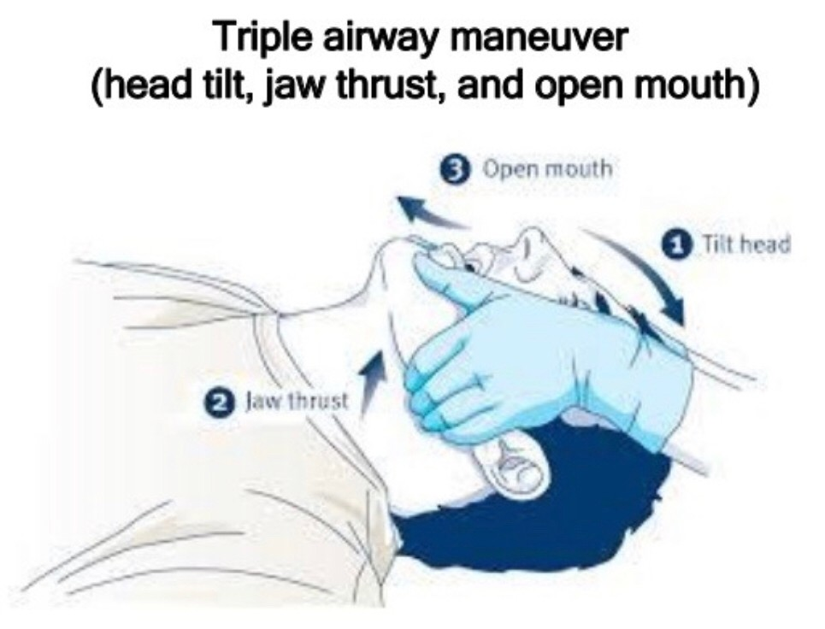

Slide 53
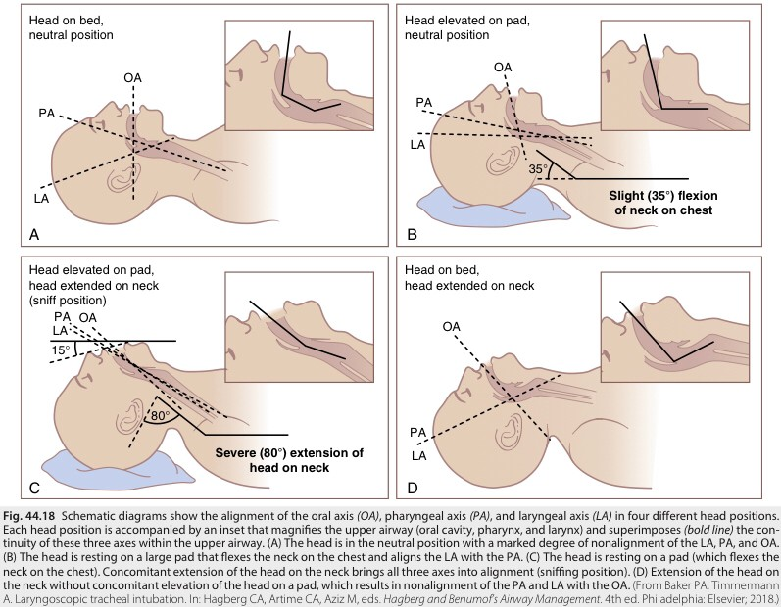
Sniffing Position
Miller’s Anesthesia 9th Edition

Slide 54
Ramp Position

Slide 55
Preoxygenation
Process of replacing nitrogen in the lung with oxygen
100% oxygen for denitrogenation
Flow rate high enough to prevent rebreathing
End tidal concentration of oxygen > 90%

Slide 56
Preoxygenation
Method
Tidal volume : ventilation via face mask 3 minutes for exchange of 95% gas in lung
Vital capacity : achieve adequate preoxygenation more radpidly [four breaths over 30 seconds , eight breaths over 60 seconds]

Slide 57
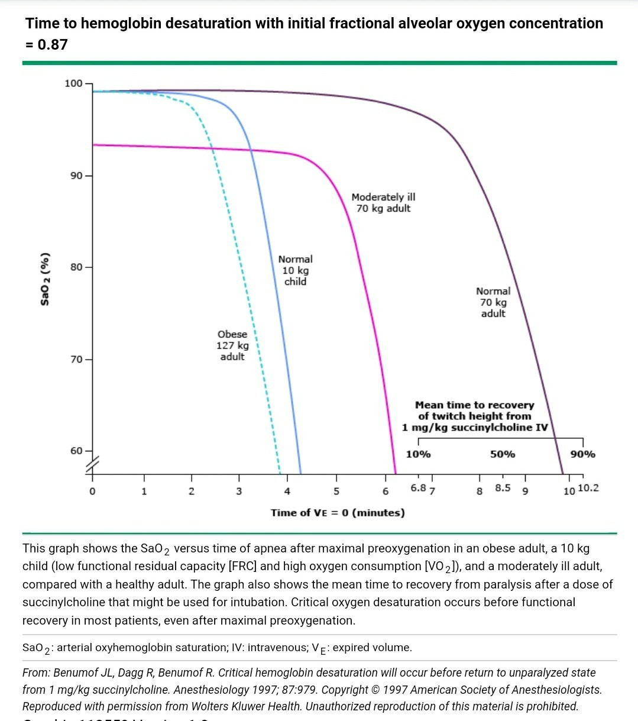

Slide 58
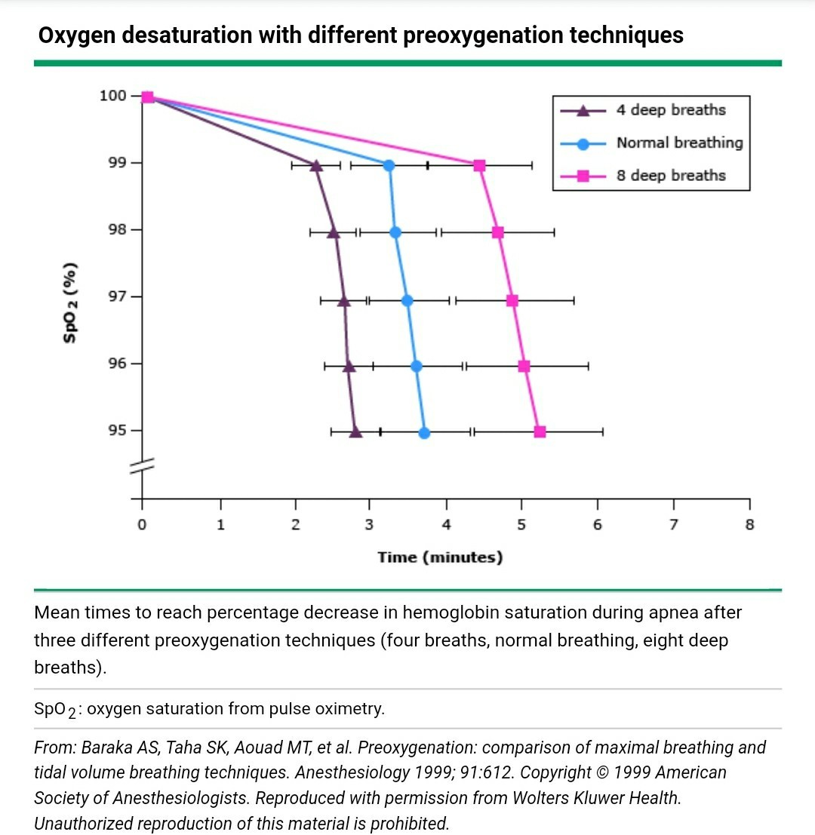

Slide 59
Mask ventilation
Preoxygenation
Inhalational induction
Two key elements
maintenance of seal between the face mask and the patient’s face
an unobstructed upper airway

Slide 60
Mask ventilation
Relative contraindicate
Risk regurgitation
Severe facial trauma
Unstable cervical spine

Slide 61
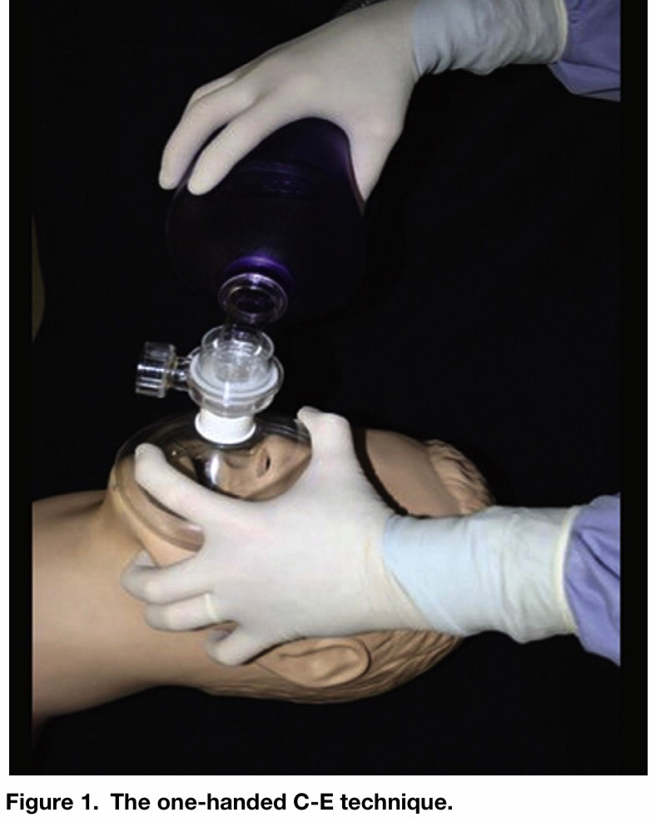
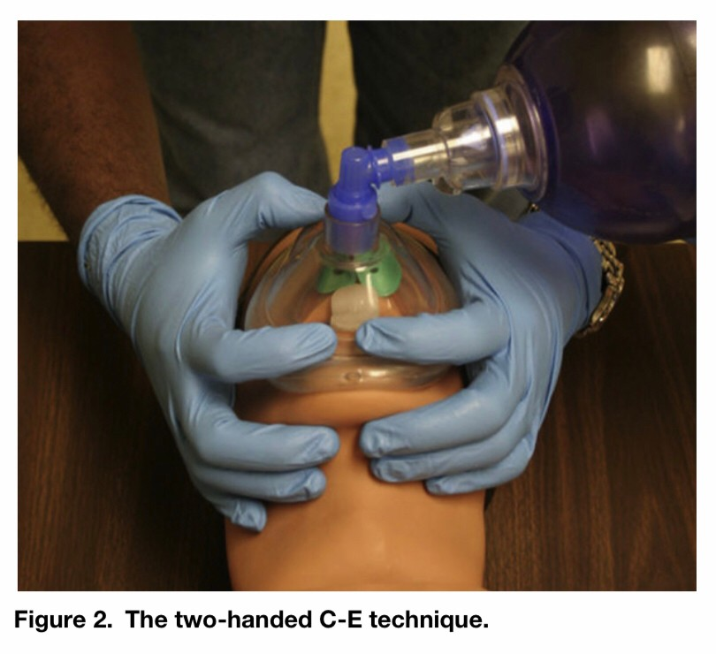
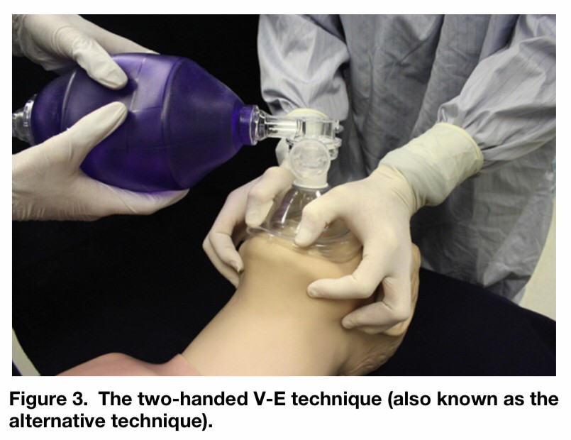
Face mask ventilation : a comparison of three techniques
Danielle Hart et al. J Emerg Med. 2013 May.

Slide 62
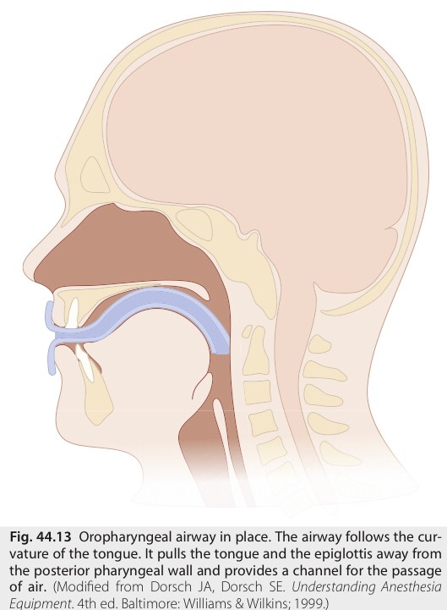
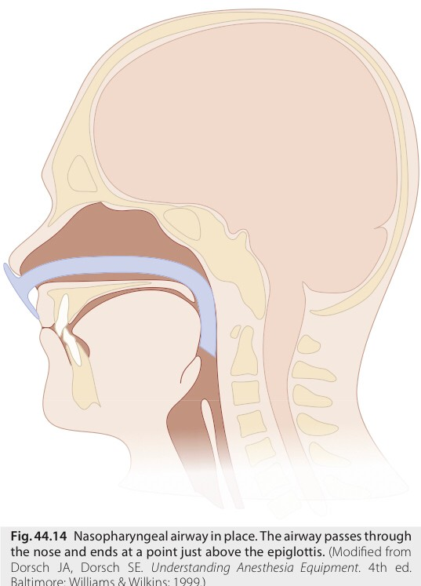
Miller’s Anesthesia 9th Edition

Slide 63
Effective of mask ventilation
Chest rise
Exhaled tidal volume
Pulse oximetry
Capnography

Slide 64
Intubation
Indication [SOAP]
Suction secretion
Prevent airway Obstructive
Aspiration
Positive pressure ventilation
Difficult mask ventilation
Surgical require NMBDs
Prolonged procedure
Cautious
Maxillofacial injury
Full stomach
Airway obstruction
Coagulopathy [nasal]
Skull base fracture [nasal]

Slide 65
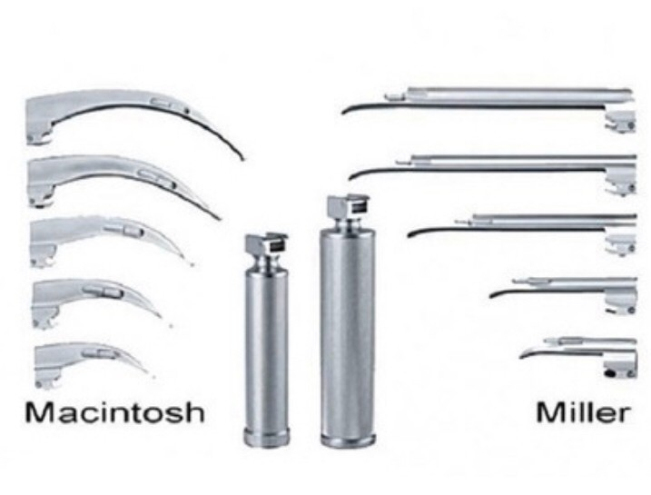
Laryngoscope
Macintosh
Miller
Curve blade
Less trauma to teeth
Adult
Straight blade
Short thyromental distance
Prominent incisors
Floppy epiglottis
Children

Slide 66
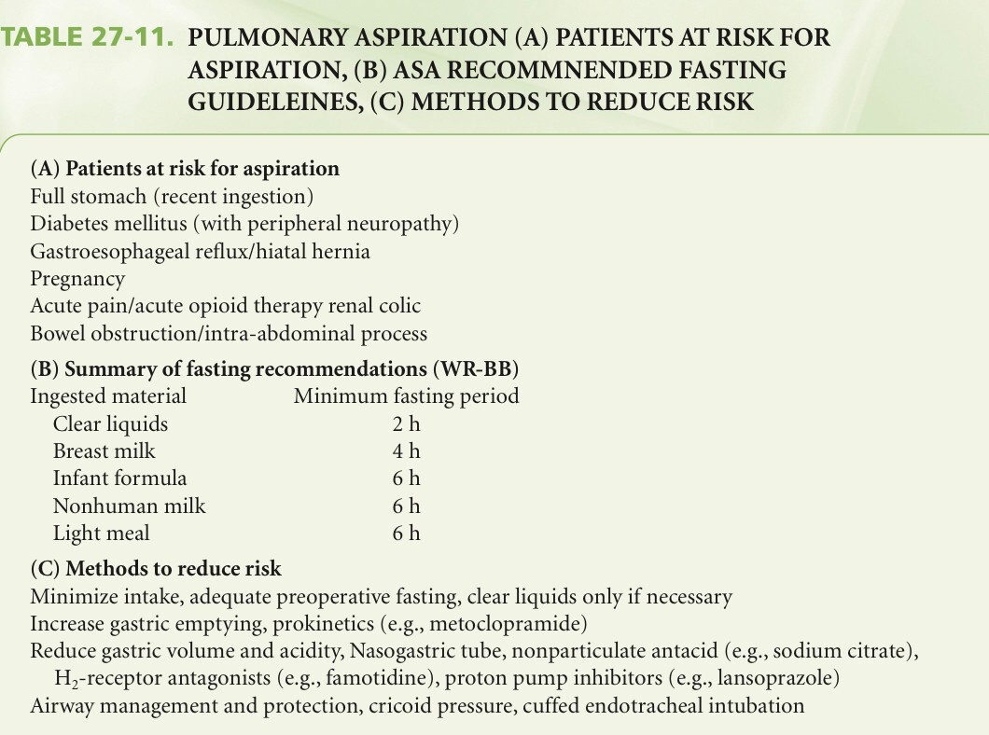
Clinical anesthesia/edited by Paul G. Barash 7th ed.

Slide 67
Aspiration prophylaxis
Decrease gastric volume and acidity
NG tube
Non particular antacid [sodium citrate]
H₂ receptor antagonist [ranithidine]
Increase gastric emptying time
Prokinetic drud [metoclopramide]

Slide 68
Rapid-Sequence induction
Indication
Cautious
Emergency intubation
Full stomach [ NPO time, pregnancy , hiatal hernia , ascites , gut obstuction]
Difficult airway [awake intubation]

Slide 69
ASA Difficult Airway management
Airway assessment
Choice of management
Awake intubation VS intubation after induction of GA
Noninvasive technique VS invasive technique
Video-assisted laryngoscopy VS initial approach intubation
Preservation VS ablation of spontaneous ventilation

Slide 70
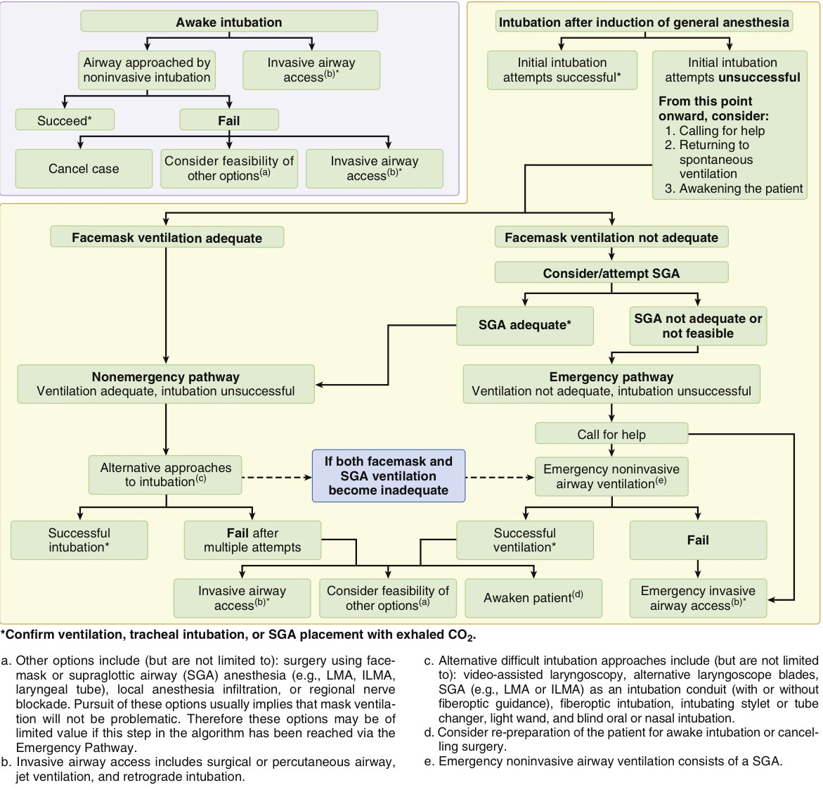
Miller’s Anesthesia 9th Edition.

Slide 71
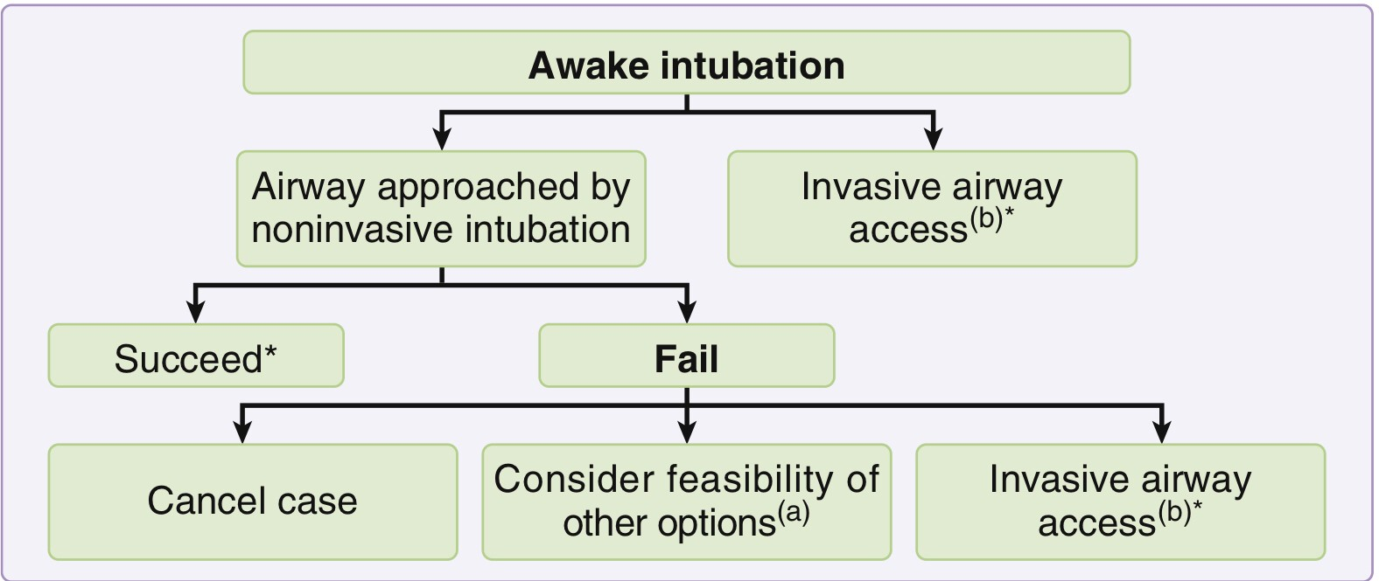
Miller’s Anesthesia 9th Edition

Slide 72
Awake intubation
Preserve pharyngeal muscle tone , patent upper airway
Flexible scope intubation [most common use]
Local anesthesia [Lidocaine]
Nerve block
Glossopharyngeal nerve
Superior laryngeal nerve
Translaryngeal nerve
Sedative drugs

Slide 73
Lidocaine
Most common use
Rapid onset , high therapeutic index , availability
Lidocaine 4% + epinephrine1% [3:1] nasal intubation
Spraying for oral airway
Focus on base of tongue [gag reflex]
Maximum dose without epinephrine is 5 mg/kg

Slide 74
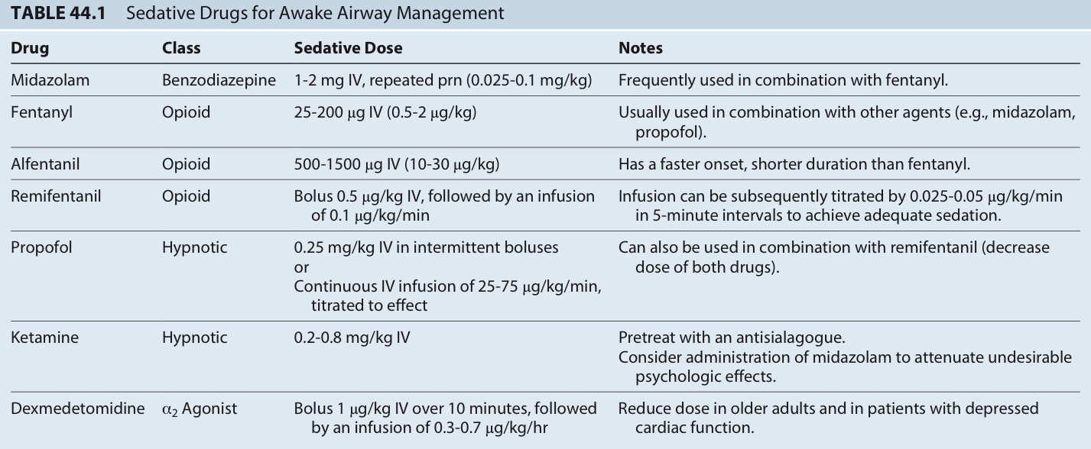
Miller’s Anesthesia 9th Edition

Slide 75
Miller’s Anesthesia 9th Edition

Slide 76
Miller’s Anesthesia 9th Edition

Slide 77
British Journal of Anaesthesia, 115 [6]: 827-48 [2015]

Slide 78
British Journal of Anaesthesia, 115 [6]: 827-48 [2015]

Slide 79
DAS guidelines 2015
British Journal of Anaesthesia, 115 [6]: 827-48 [2015]

Slide 80
DAS guidelines 2015
British Journal of Anaesthesia, 115 [6]: 827-48 [2015]

Slide 81
DAS guidelines 2015
British Journal of Anaesthesia, 115 [6]: 827-48 [2015]

Slide 82
DAS guidelines 2015
British Journal of Anaesthesia, 115 [6]: 827-48 [2015]

Slide 83
DAS guidelines 2015
British Journal of Anaesthesia, 115 [6]: 827-48 [2015]

Slide 84
Supraglottic airway device
LMA classic
LMA Proseal
LMA Supreme
LMA Fastrach
I-Gel
Air-Q
Laryngeal tube

Slide 85
Miller’s Anesthesia 9th Edition

Slide 88
Retrograde Intubation
Anticipated difficult intubation
To bypass existing tracheostomy
Trismus
Congenital anomalies
Trauma
Tumor
Failed intubation
Miller’s Anesthesia 9th Edition

Slide 89
Emergency Front of Neck access
Transtraheal jet ventilation [TTJV]
Cricothyrotomy
Tracheostomy [surgeon]

Slide 90
Transtraheal jet ventilation
Emergent invasive technique
Provide adequate , temporary oxygenation and ventilation
Complication
Barotrauma
Should not perform
Cricoid cartilage injury
Complete upper airway obstruction
Coagulopathy
Obstructive pulmonary disease

Slide 91
Cricothyrotomy
Emergency invasive pathway
Percutaneous
Surgical
Contraindication
Chlidren < 6 years
Laryngeal fractures
Laryngeal neoplasm
Subglottic stenosis
Coagulopathy

Slide 92
Extubation
Risk complication > intubation
Fully awake extubation VS deep extubation
Bailey maneuver

Slide 93
Clinical anesthesia/edited by Paul G. Barash 7th ed.

Slide 95
Guidelines from the Difficult Airway Society, the Association of Anaesthetist the Intensive care
Society, the Faculty of Intensive Care Medicine and the Royal College of Anaesthetists 2020

Slide 96
Summary
Limit staff : one intubator ; one assistance ;and one to administer drugs and monitor
Wear full PPE
Intubate in negative pressure room
Pre-oxygenation with a well-fitting mask and a Mapleson C or anesthetic circuit
2-hand mask ventilation with VE-grip

Slide 97
Summary
Avoid aerosal-generating procedure
Use RSI with cricoid pressure
Avoid circuit disconnection
Clamp tube and pause ventilator for airway manoeuvers or disconnections

Slide 98
Guidelines from the Difficult Airway Society, the Association of Anaesthetist the Intensive care
Society, the Faculty of Intensive Care Medicine and the Royal College of Anaesthetists 2020

Slide 100
Guidelines from the Difficult Airway Society, the Association of Anaesthetist the Intensive care
Society, the Faculty of Intensive Care Medicine and the Royal College of Anaesthetists 2020

Slide 101
Guidelines from the Difficult Airway Society, the Association of Anaesthetist the Intensive care
Society, the Faculty of Intensive Care Medicine and the Royal College of Anaesthetists 2020

Slide 102
Guidelines from the Difficult Airway Society, the Association of Anaesthetist the Intensive care
Society, the Faculty of Intensive Care Medicine and the Royal College of Anaesthetists 2020

Slide 103
Take home massege
No single screening test for adequate preoperative airway assessment
Always have back-up plans
Maintenance of oxygenation is the priority
Do not delay in progression to cricothyroidotomy

